Slide 1





BUSINESS DATA MANAGEMENT
CAPSTONE PROJECT
Project on:
Transforming Jaiswal Cycle Stores: Data Strategies for Bicycle
Retail Success.
Presented By:
Satish Jaiswal (21f2000142)

Slide 2




OUTLINE
Analysis on Collected Data of Products and their Details
About Jaiswal Cycle Stores
Problem Statement
Recommendations

Slide 3
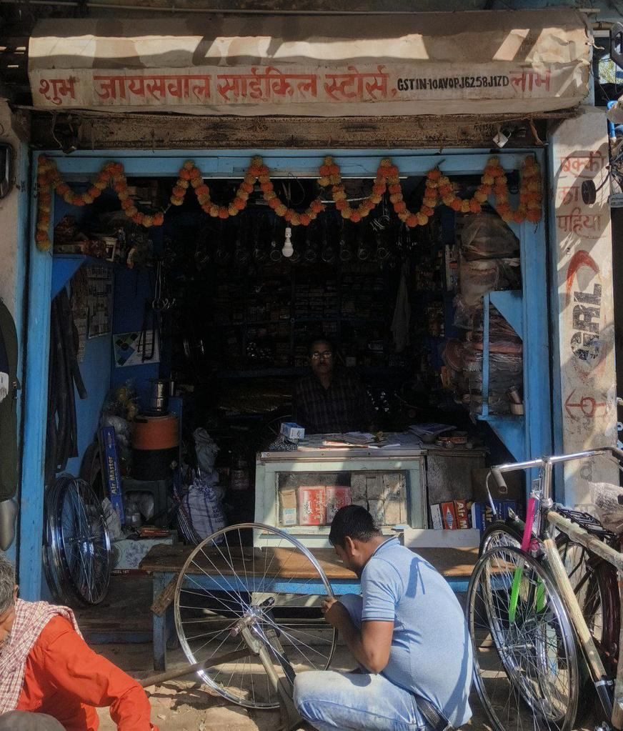
JAISWAL CYCLE
STORES
Jaiswal Cycle Stores, nestled in the heart of Kunwar Singh Chowk, Main Road Jainagar, Madhubani-847226, stands as a reliable destination for bicycle enthusiasts seeking quality products and exceptional service. Established by the visionary Nand Kumar Jaiswal, this shop has been a cornerstone of the community, providing eco-friendly and affordable transportation solutions.
From sleek bicycles to essential accessories, Jaiswal Cycle Stores caters to the diverse needs of its customers. Nand Kumar Jaiswal's dedication to excellence resonates in every product offered, ensuring customers receive top-notch quality and value.
With an average monthly sale of ₹4,45,180, Jaiswal Cycle Stores has earned the trust and loyalty of its patrons. It's not merely a shop but an integral part of the neighborhood, fostering connections and delivering superior products with a personal touch.

Slide 4


PROBLEM STATEMENT
Reduced bicycle sales due to rising demand for motorized alternatives, endangering its market position.
Encounters a significant sales decline during the rainy season, lasting 2-3 months, posing financial hurdles.

Slide 5

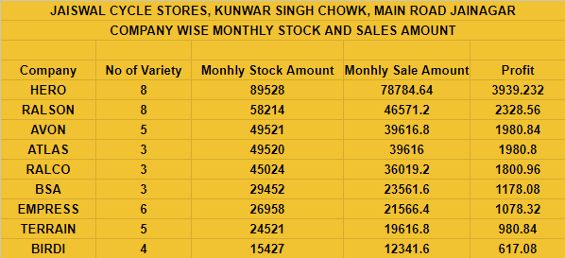
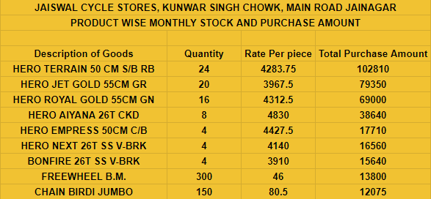
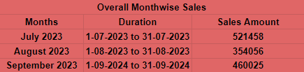
ANALYSIS ON COLLECTED DATA OF PRODUCTS AND THEIR DETAILS
Collecting relevant data from the shop's sales records and inventory systems.
After collection, the data underwent thorough cleaning.
The data will be presented visually using appropriate charts, graphs, and tables to enhance comprehension.

Slide 6
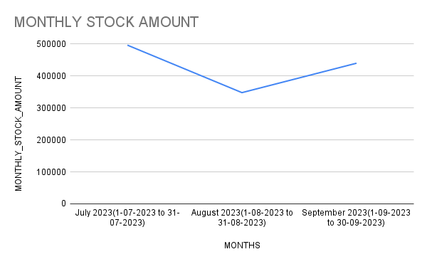
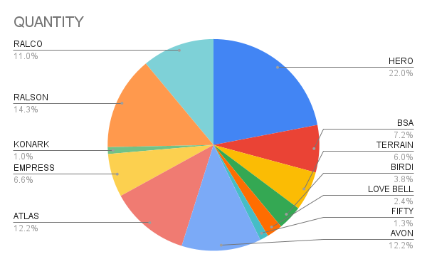
Monthly Stock Amount
The Monthly Combined Stock Chart illustrates the quantities of different items in stock across months, aiding in identifying trends and potential inventory imbalances.
Stock Pie Chart
The Stock Amount Pie Chart visually depicts the allocation of total stock values among various items, emphasizing each product's contribution to the overall inventory value. This aids in efficient prioritization and allocation of resources.

Slide 7
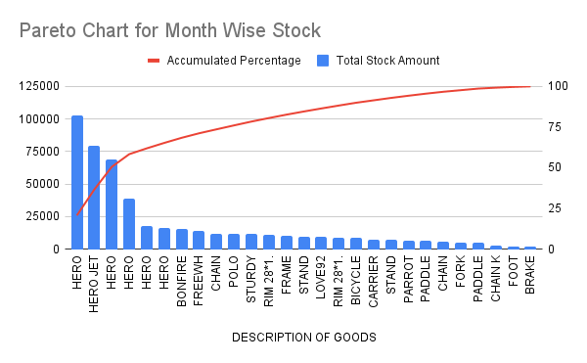
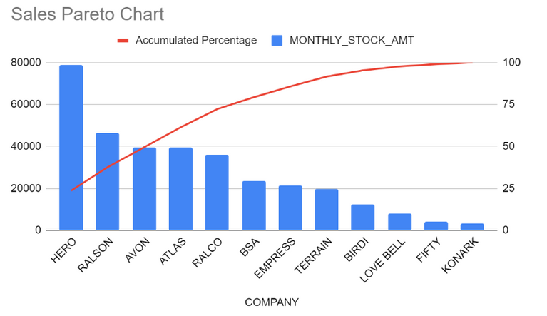
Items Stock Pareto Chart
The Stock Pareto Chart displays products in descending order of stock quantities, helping identify the key items and their respective companies that contribute the most to inventory levels. This enables a focus on targeted inventory management strategies.
Sales Pareto Chart
The Sales Quantity Pareto Chart organizes products based on descending sales quantities, helping identify the key items by company that significantly drive most of the sales. This aids in focusing efforts to enhance sales for these particular items.

Slide 8
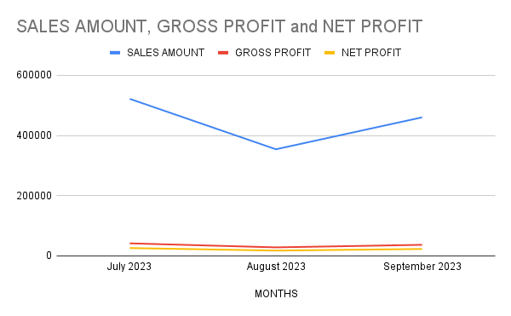
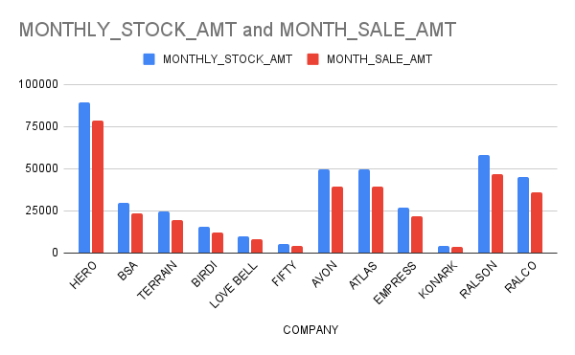
Monthly sales & profit trends
Sales Trends:
Monthly sales exhibit fluctuations, with July marking the highest at ₹5,21,458.
Consistently stable profit margins indicate steady profitability.
Insights into Customer Preferences:
Rain influences buying patterns, notably higher sales during July and lowest in August(heavy rainy season) followed by September(less rain as compared to August).
August's sales surge is attributed to the onset of the Rainy season, influencing the number of customers in the market.
Top-Selling Products and Companies:
Hero dominates both sales and stock, followed by Ralson and Ralco.
Ralson offers a diverse variety but contributes less to sales compared to Hero.
HERO TERRAIN 50 CM S/B RB, HERO JET GOLD 55CM GR, HERO ROYAL GOLD 55CM GN, and BONFIRE 26T SS V-BRK collectively drive 57% of total sales.
Customer Preference Patterns:
Hero’s diverse product range holds a substantial share in customer preferences.
Terrain and Empress products closely follow in popularity.
July and September emerge as favored months for Bicycle and its related product purchases, with less rain resulting in more customers.
Monthly stock and sales

Slide 9

RECOMMENDATIONS
FOR DECLINING BICYCLE SALES
1. Market Research: Understand factors driving motorized preference and identify opportunities for bicycle positioning.
2. Product Innovation: Introduce advanced bicycle models like gear types to differentiate from motorized options.
3. Promotional Campaigns: Highlight bicycle benefits in targeted marketing, emphasizing eco-friendliness and health.
4. Enhanced Customer Experience: Improve in-store displays, offer test rides, and implement loyalty programs.
5. Pricing and Financing: Ensure competitive pricing and offer financing options for accessibility.
6. Community Engagement: Sponsor cycling events, partner with local businesses, and promote bike safety.

Slide 10

RECOMMENDATIONS
FOR SEASONAL SALE FLUCTUATIONS
1. Product Diversification: Introduce indoor cycling accessories and non-seasonal items like maintenance products.
2. Seasonal Promotions: Launch targeted discounts and highlight weather-resistant bicycle models.
3. Flexible Pricing: Implement dynamic pricing and offer bundle deals to manage sales fluctuations.
4. Customer Engagement: Enhance communication through email campaigns and loyalty programs.
5. Collaboration with Weather: Related Businesses: Partner with umbrella shops or fitness centers for joint promotions.
6. Inventory Management: Use software for sales forecasting and maintain lean inventory levels.
7. Community Engagement: Organize indoor cycling events and partner with charities to boost store foot traffic.
THANK YOU FOR YOUR TIME AND ATTENTION.

